Slide 1

Can Pessimism/Optimism Presage the Market?
Jeffrey Oller

Slide 2
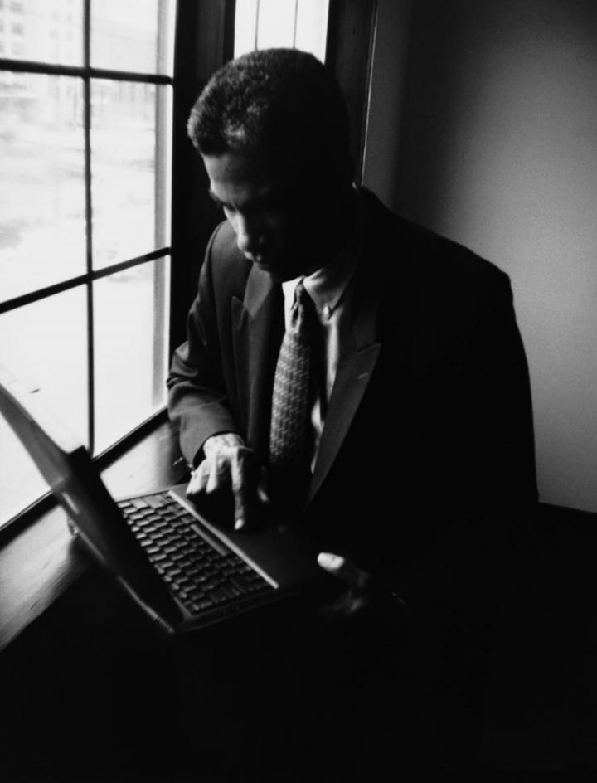
Previous Research
Pessimistic rumination in popular songs and newsmagazines predict economic recession via decreased consumer optimism and spending
Analyzed lyrics from 1955 to 1989.
Found that pessimism in popular music predicted other forms of pessimism in media and eventually economic pessimism as measured by GNP growth.
Notes:
1991 research
Through the 90s
Featured in Media
Television and Newspaper

Slide 3

WHAT HAS CHANGED
New data
Time Series Modelling
Billboard 100 (1958-2022)
Exploring how GDP relates to itself as well as past lyric sentiment
New Techniques
Effect of COVID
NLP
TextBlob sentiment analysis
Big dip in both GDP and pessimism
Notes:
New Data
New and Simpler NLP techniques

Slide 4
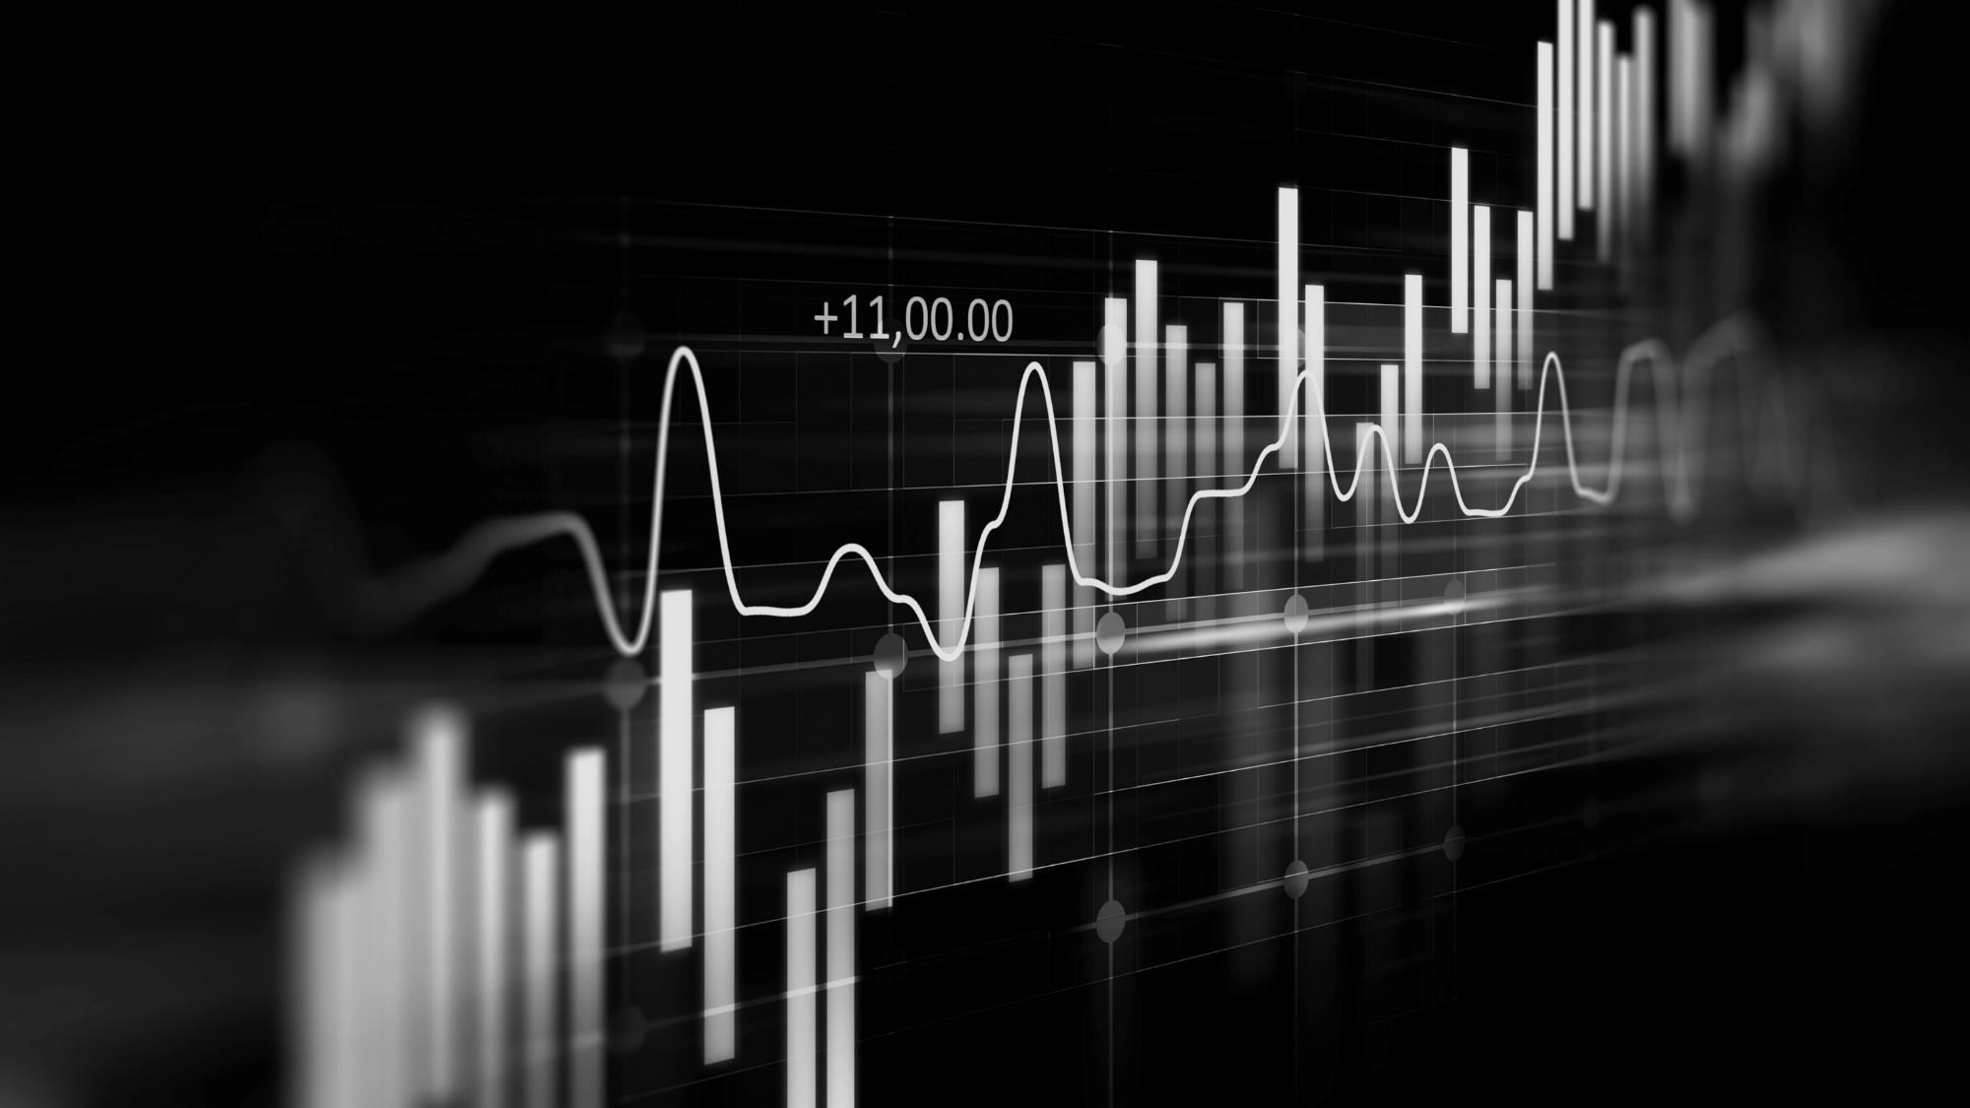
PROBLEM
Problem
Consumer pessimism
Market Growth
What effects do pessimism have?
Can pessimism explain part of market volatility?
Stock Prices
Upcoming Recession
Does pessimism have implications for investors?
If we see a rapid rise in pessimism, should we expect a recession?
Notes:
Why is this interesting?
Consumer pessimism
Effect on consumption and market?
Investors
Everyone wants to know if a recession is upcoming

Slide 5

GOAL
GOAL
Use lyric sentiment to predict GDP growth per capita (in the USA)
Reproduce results from 1989 paper

Slide 6
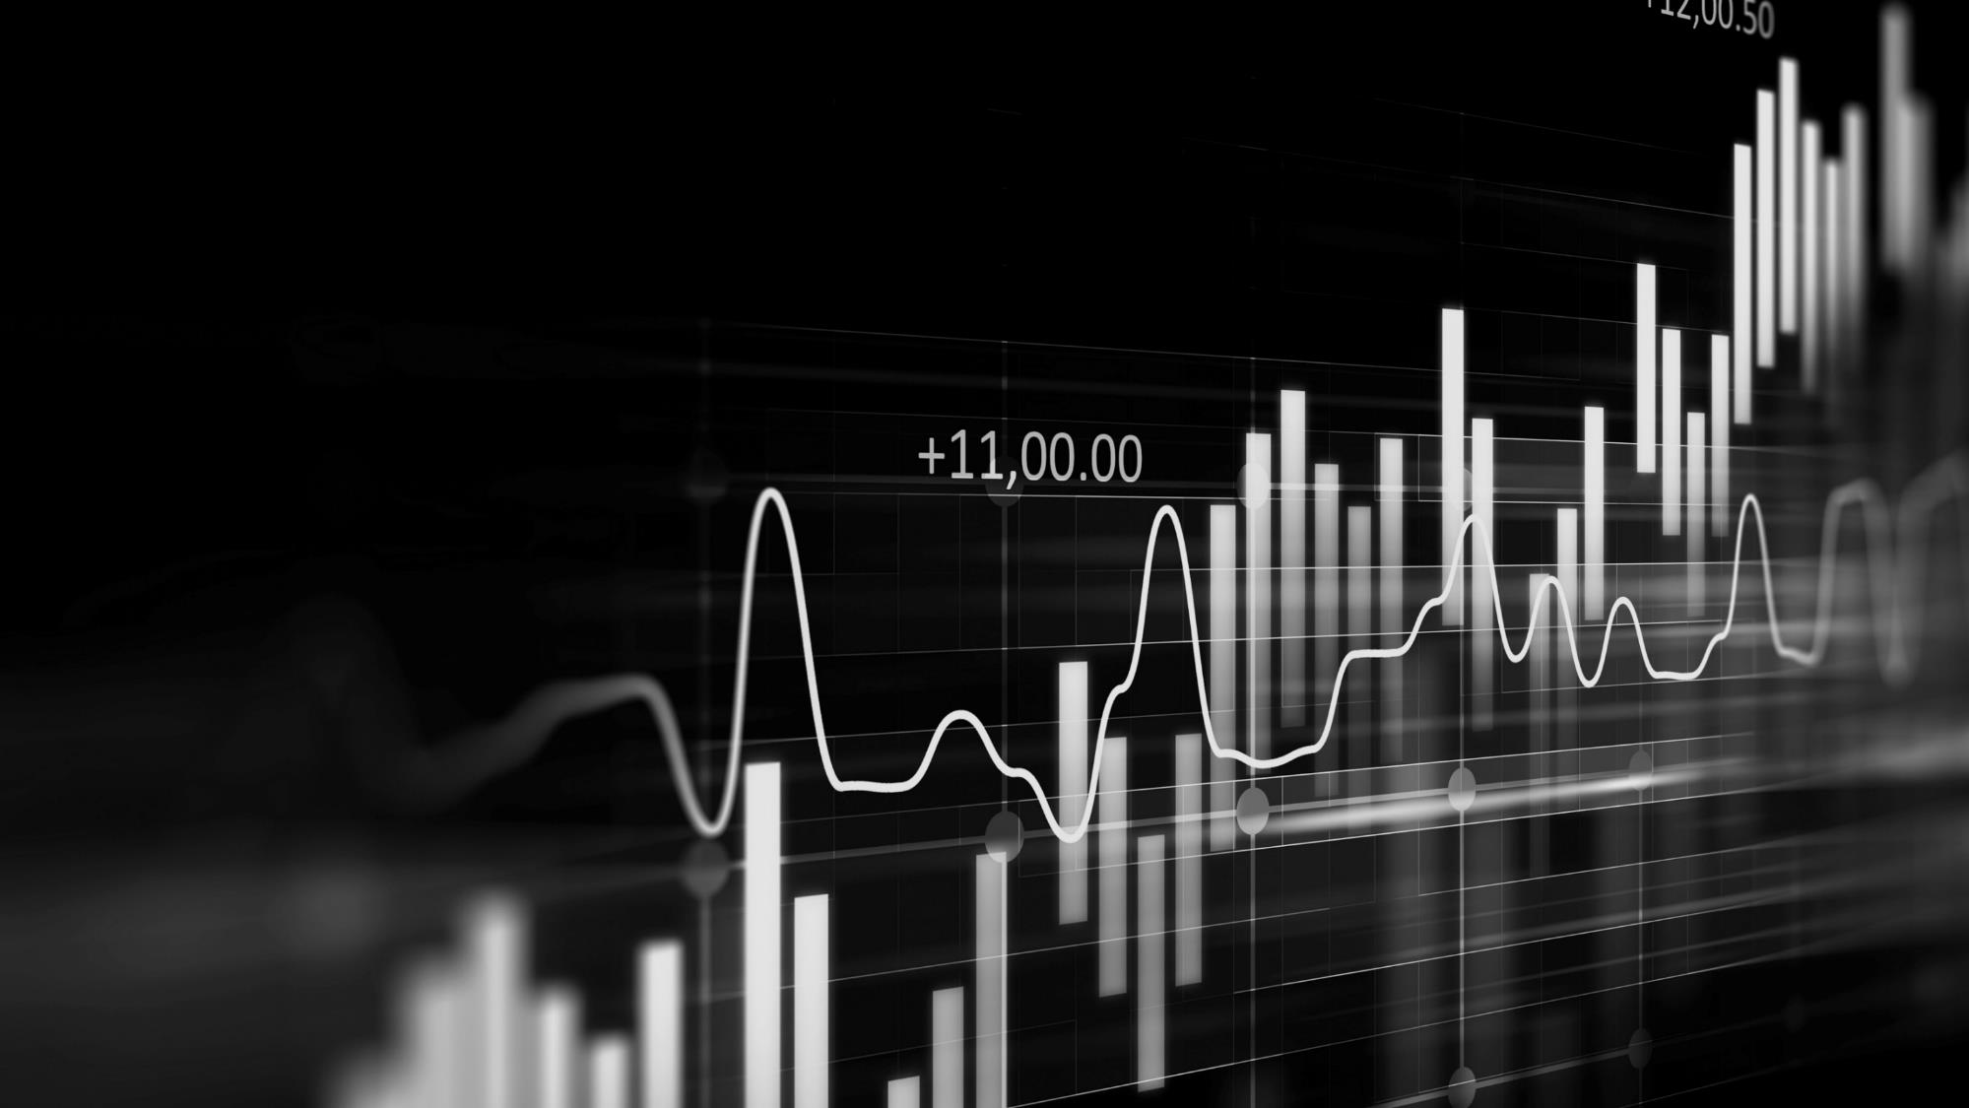
DATA SOURCES
Music titles
Music lyrics
Gdp per capita
Billboard Hot 100:
Github repository with .csv
Weekly Data
Genius API
Remainder scraped from songlyrics.com
GDP data collected from the US Bureau of Economic Analysis (BEA)

Slide 7
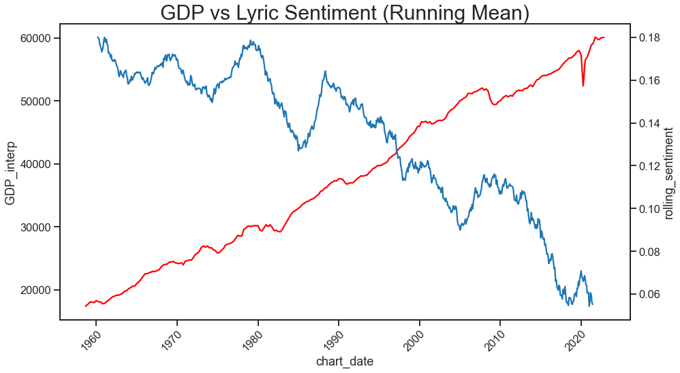
Notes:
Covid Dip!

Slide 8
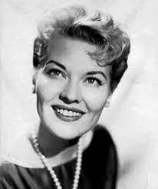
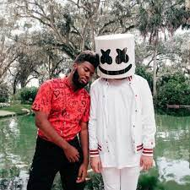
SONG LYRICS
Title/Artist | Lyrics | Sentiment
Say Wonderful Things 1962 Patti Page | Say wonderful things to me I think you're wonderful too Say wonderful things to me Especially I love you | .875
Numb 2022 Khalid and Marshmello | I, I wanna get numb And forget where I'm from 'Cause lookin' in your eyes Like lookin' at the sun I feel like you're the moon I feel like I'm the one I wanna get numb, numb, numb, numb | -.511
Notes:
Lyrics data converted into a sentiment score
Two love songs
1962 – typical pre protest-rock
2022 – Love song with negative wording

Slide 9
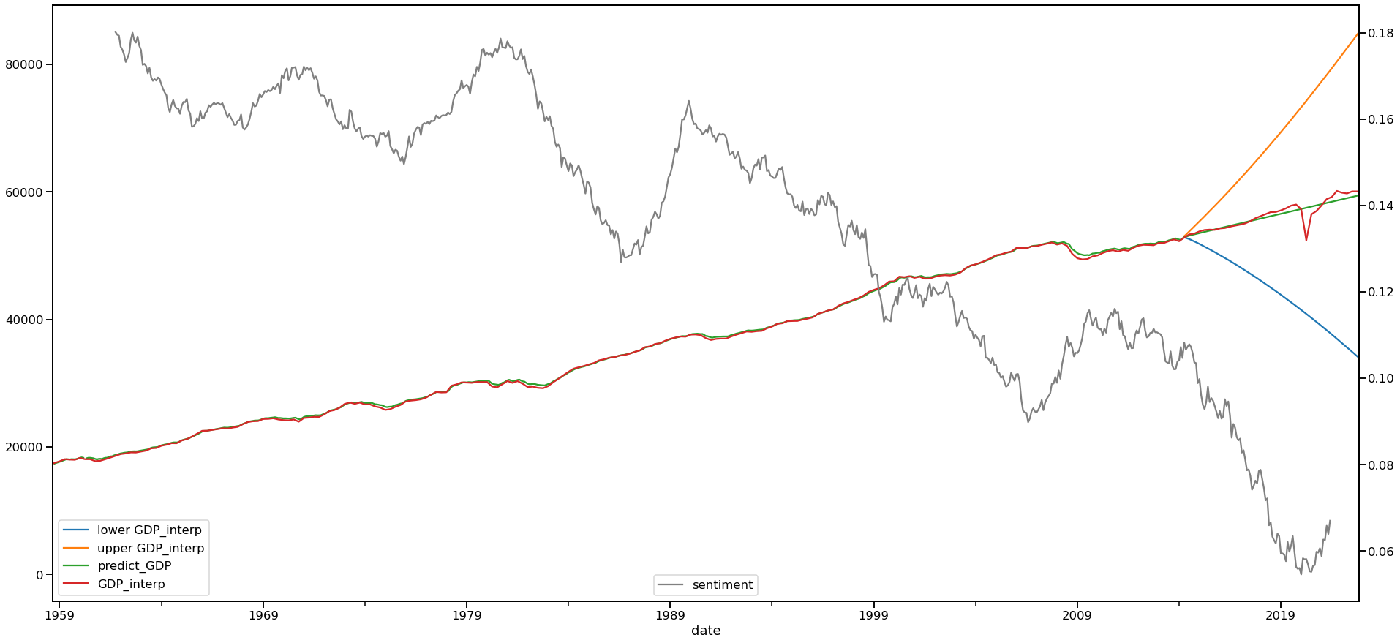
RESULTS:
GDP – ACTUAL AND PREDICTED VS LAGGED LYRIC SENTIMENT (19 MONTH LAG - RUNNING MEAN)

Slide 10
POSSIBLE IMPROVEMENTS
More data
Use other sources of sentiment data (headlines, newspaper articles, etc.)
Predict stock prices rather than GDP
Would improve granularity since GDP is collected quarterly
Find other indicators of pessimism
More Sophisticated Model
LSTM model

Slide 11

TECHNICAL PRESENTATION

Slide 12

MODEL
DATA
Feature Engineering
Time Series analysis
Weekly Sentiment aggregated by month
Quartlerly GDP data imputed by month
LASSO regression helps us determine how long ago to look at pessimism
SARIMAX handles autocorrelation as well as the lagged sentiment from step 1

Slide 13
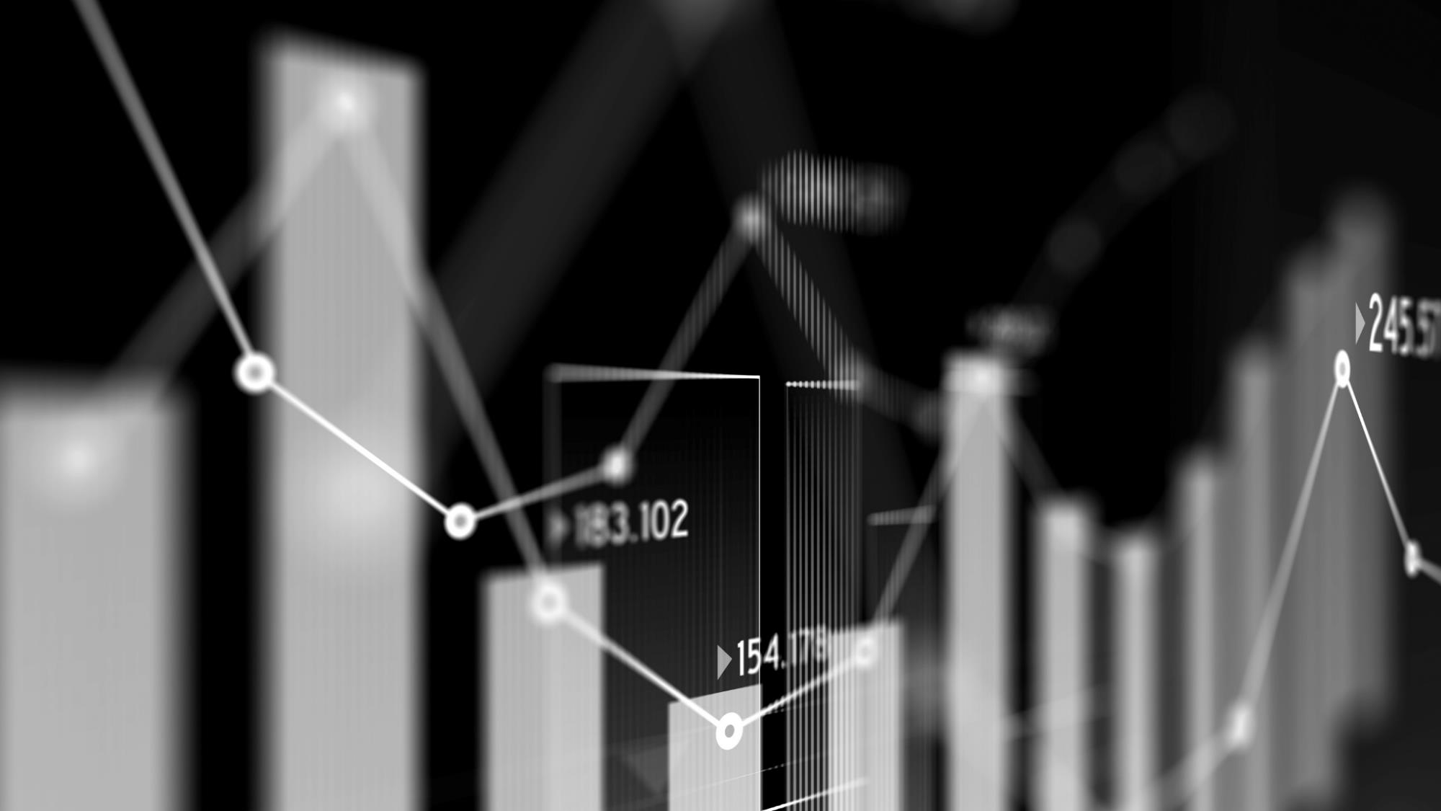
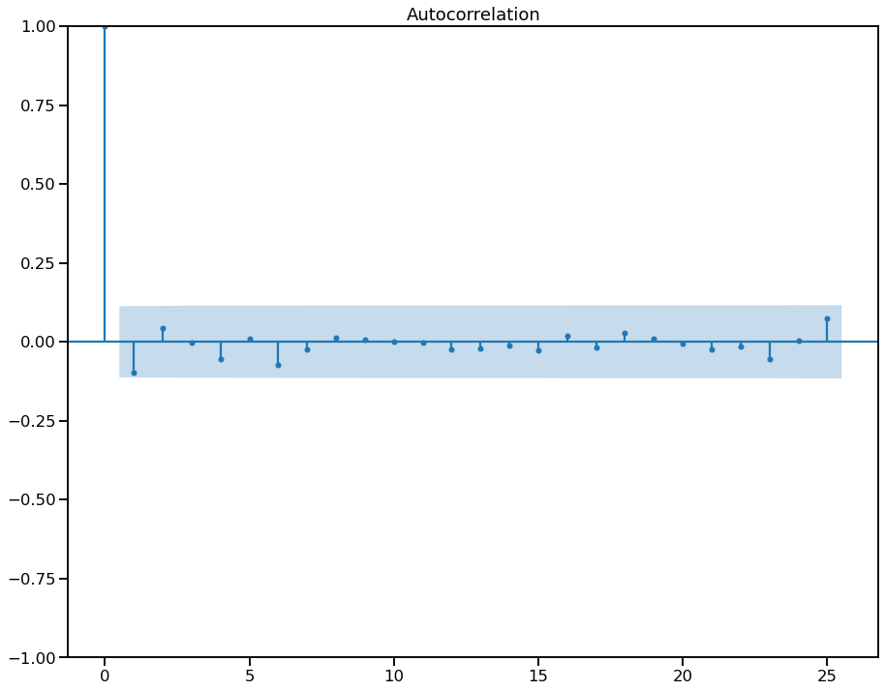
STATIONARITY
GDP
LYRIC SENTIMENT
Dickey-Fuller test yields stationarity at
p = 1.276 × 10⁻³
Dickey-Fuller test yields stationarity at
p = 1.285 × 10⁻²³
Autocorrelation by quarter

Slide 14
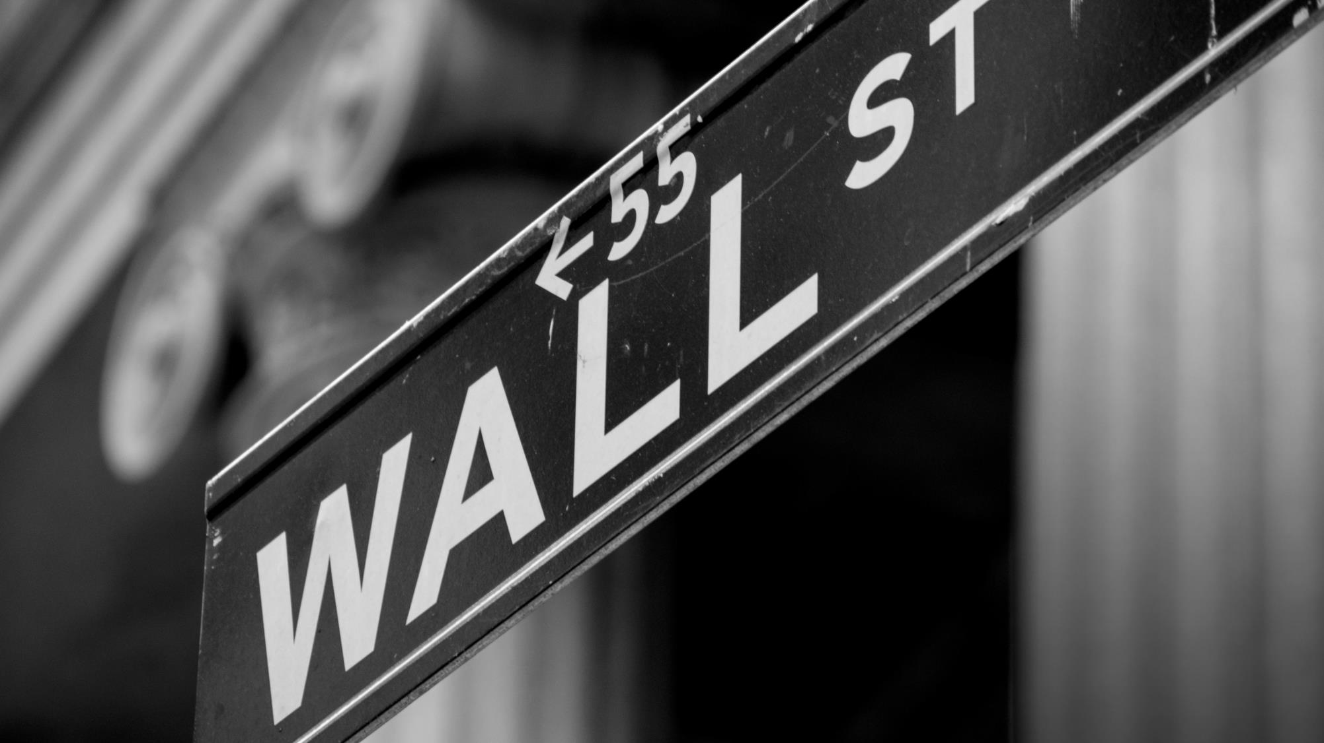
Thank You
Jeffrey Oller
415-323-3539
jeffreytoller@gmail.com
linkedin.com/jeffreyoller
github.com/jeffreytoller
kaggle.com/jeffreyoller

